Slide 1
Asset Management Techniques under ESG constraints: Efficient Frontier Analysis and Portfolio Weights Forecasting with a Kalman Filter
10.12.2025 | Matteo Callini

Slide 2
Contents
Introduction
Asset management techniques considering ESG scores
Weights Forecasting
Discussion and Comparison with Literature

Slide 3





Discipline focused on allocating capital across financial instruments to balance return, risk and liquidity.
Built on multifactor models and robust optimization, the discipline has moved from qualitative to quantitative and data-driven approaches.
Environmental: climate risks, emissions, resources, energy use
Social: labor standards, human rights, diversity, product responsibility
Governance: transparency, board quality, ethics, shareholder rights
ESG performance is measured using composite ESG scores from Refinitiv, providing a standardized metric for sustainability assessment across firms.
Asset Management
ESG Scores and Sustainable Investing

Slide 4


How do explicit ESG constraints reshape the efficient frontier and portfolio performance?
Data & Methodology
Universe: S&P 500 constituents
ESG Scores: Refinitiv
In-sample Data: 2015–2022
Out-of-sample Testing: 2023–2024
Metrics: Annualized Return, Volatility, Sharpe Ratio, Max Drawdown, Calmar Ratio
ESG Integration in Asset Management
ESG-constrained optimization
Negative screening
Linear limits on low-ESG assets
Best-in-Class selection
Long-only vs. limited short-selling regimes.
Introduction of the Kalman Filter to forecast portfolio weights.

Slide 5
Azzone, Barucci & Stocco “Asset management with an ESG mandate”
  ESG as a portfolio-level constraint
  Limited efficiency losses when the constraint is properly calibrated.
De Spiegeleer “ESG: A New Dimension in Portfolio Allocation”
  Best-in-Class approach as a sector-aware method that balances high-ESG long positions with low-ESG short exposure
Blitz & Swinkels “Does excluding sin stocks cost performance?”
  Broad exclusions reduce diversification and increase active risk
  Moderate and well-calibrated screening preserves efficiency.
Initial dataset: S&P 500 constituents with their corresponding ESG scores.
  Keep only assets with available ESG scores and remove illiquid assets
  Select top 100 assets by market capitalization (to avoid sparse frontiers)
  Winsorize returns at the 5% tails to remove outliers
Final universe: 93 assets. Another subset with the top 50 ESG Score assets is considered in order to evaluate the exclusion effect.
Literature Review
Data
Filtration

Slide 6
Asset management techniques considering ESG scores

Slide 7
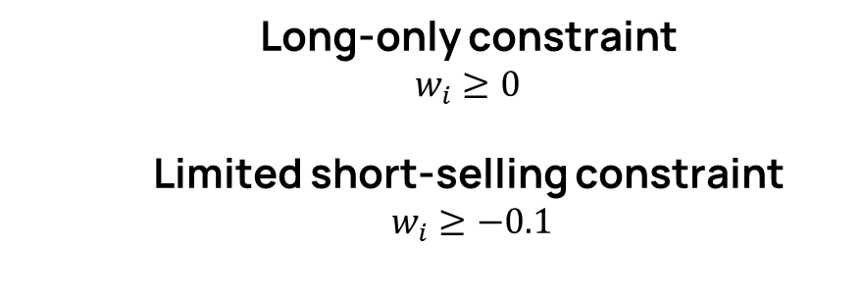
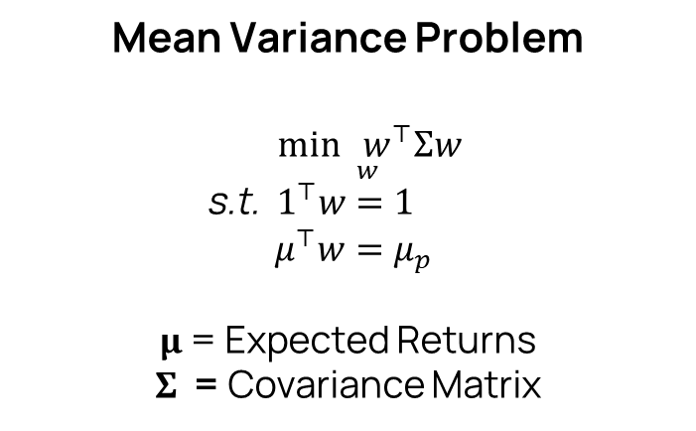
Standard Frontier
Mean Variance Problem
$\underset{w}{\min{w^{⊤}Σw}} \text{s}\text{.}\text{t}\text{. }{ 1}^{⊤}w=1$
$μ^{⊤}w=μ_{p}$
µ = Expected Returns
Σ = Covariance Matrix
  Long-only constraint
  $w_{i}≥0$
  Limited short-selling constraint
  $w_{i}≥−0.1$
Long-only constraint :
Economically interpretable and more stable than short selling case.
Slightly less efficient than the unconstrained case.
Limited short-selling constraint :
Improve diversification and slightly improve performance.
Too-large short bounds cause numerical instability.

Slide 8
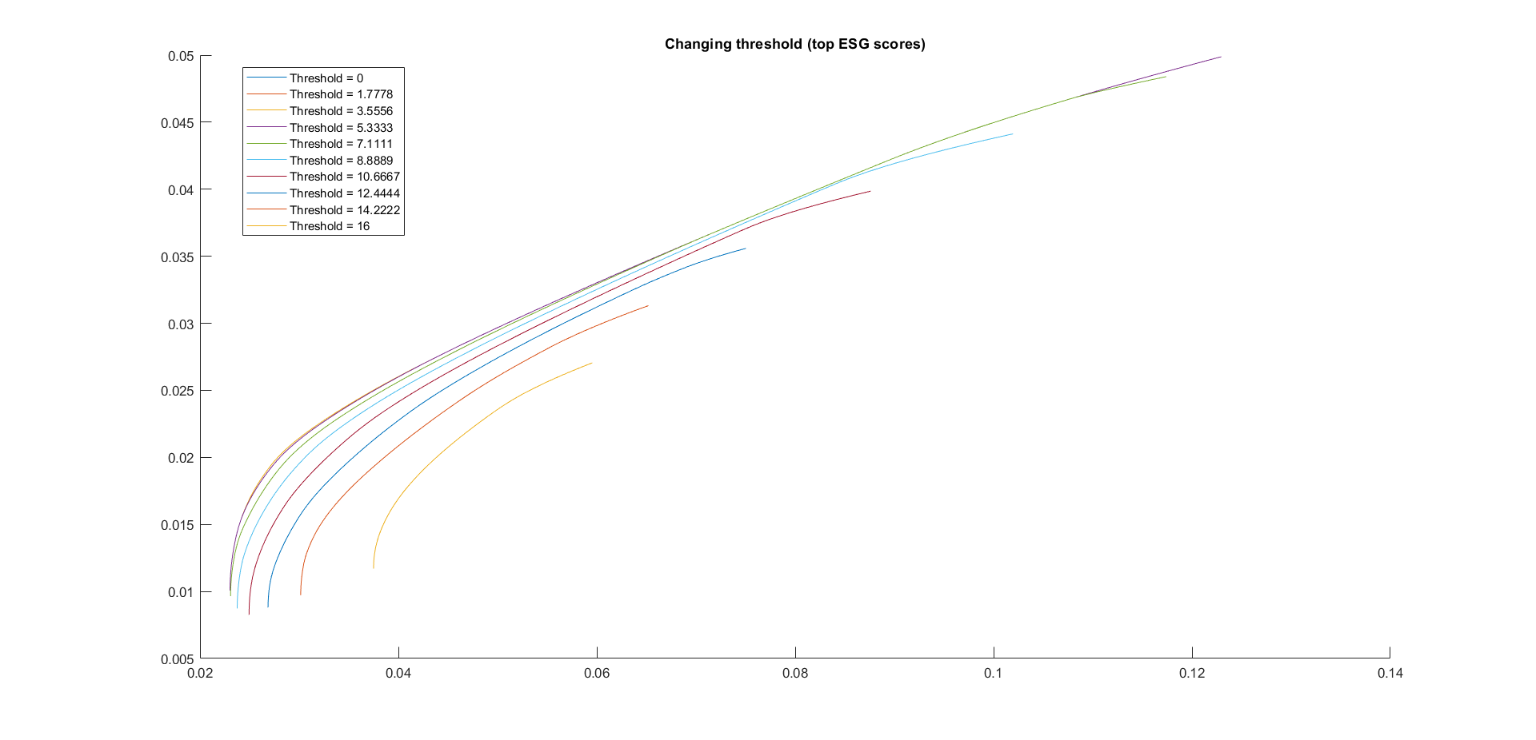
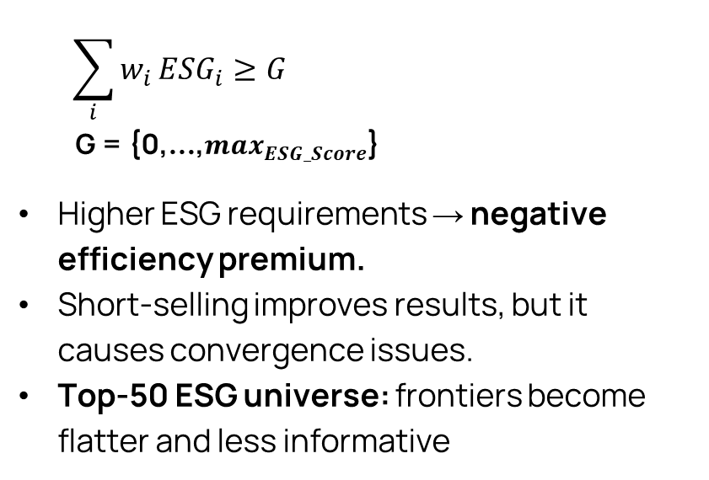
ESG Integration via Constrained Optimization
$$\sum_{i}{w_{i}}ESG_{i}≥G$$
G = {0,…,$\max_{ESG_Score}$}
Higher ESG requirements → negative efficiency premium.
Short-selling improves results, but it causes convergence issues.
Top-50 ESG universe: frontiers become flatter and less informative
{
Minimum Variance Portfolio
Volatility rises from 8% to 13% as G increases.
Sharpe Ratio falls from 1.5 to 1.1 when ESG requirements become stricter. Considering limited short selling SR > 1.8.

Slide 9
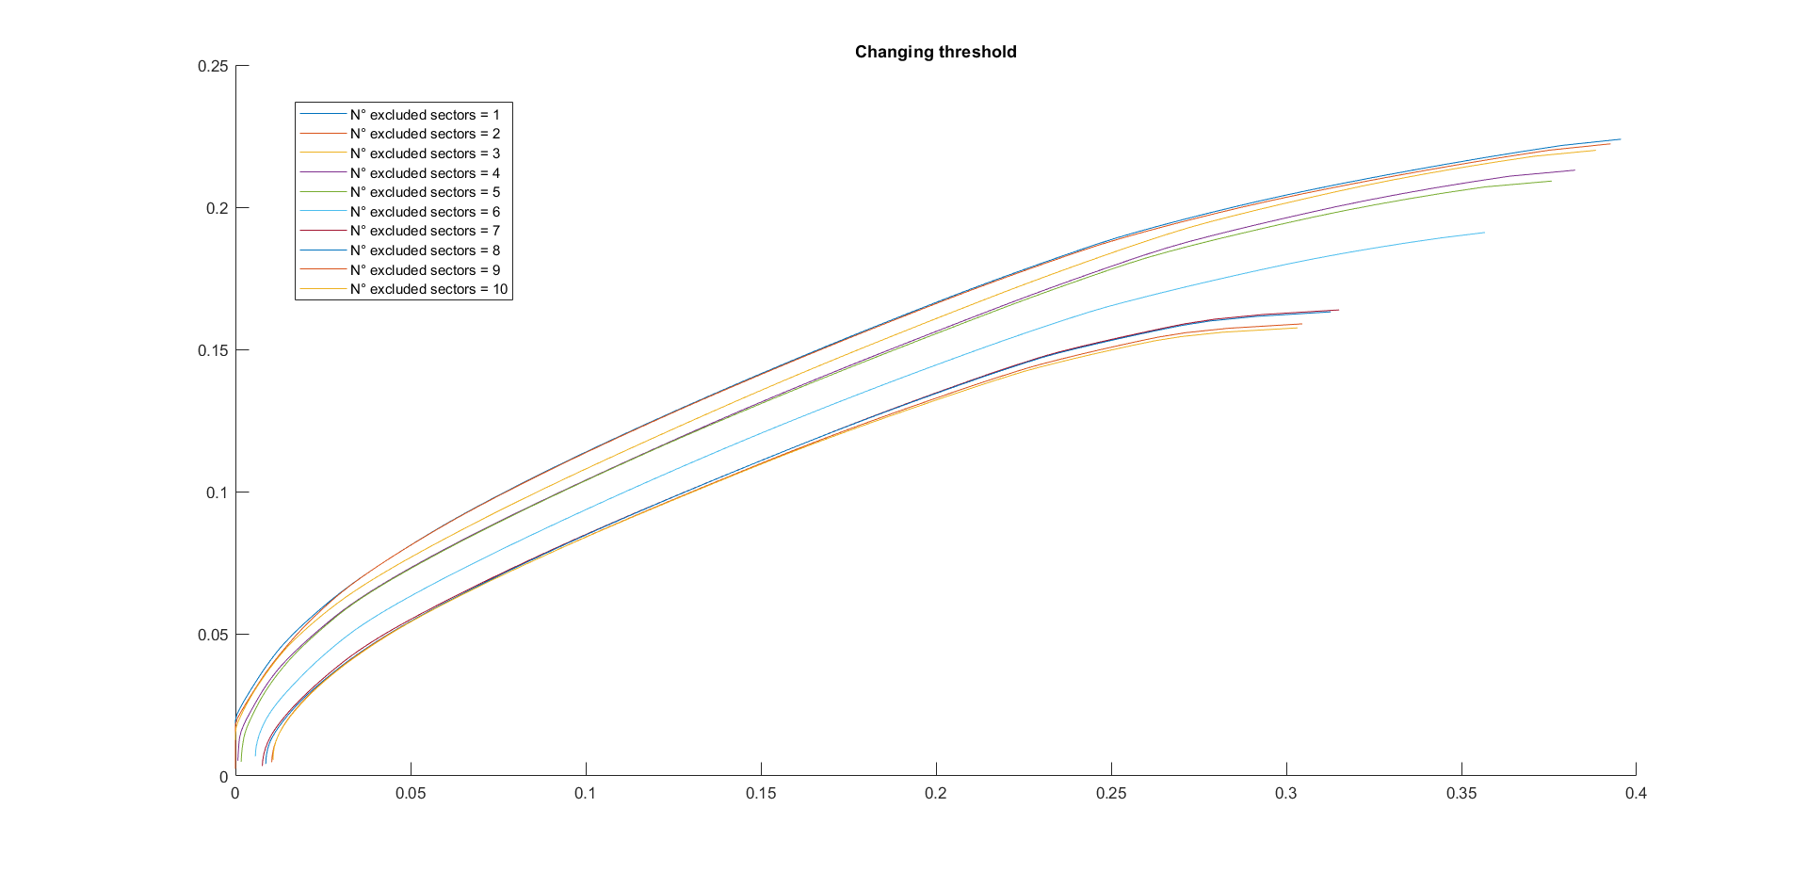
Negative Screening — Sectorial Analysis
In the negative screening, entire low-ESG sectors are removed from the investable universe.
Screening intensity tested by excluding 1 to 10 sectors.
Moderate exclusion portfolios (up to 5 sectors) present good performance.
Minimum Variance Portfolio
Moderate screening: Sharpe Ratios can reach 1.4.
Excessive exclusions: Maximum Drawdown increases significantly, reaching −20% in worst cases.
Volatility becomes higher than the other portfolio configurations, confirming concentration risk.

Slide 10
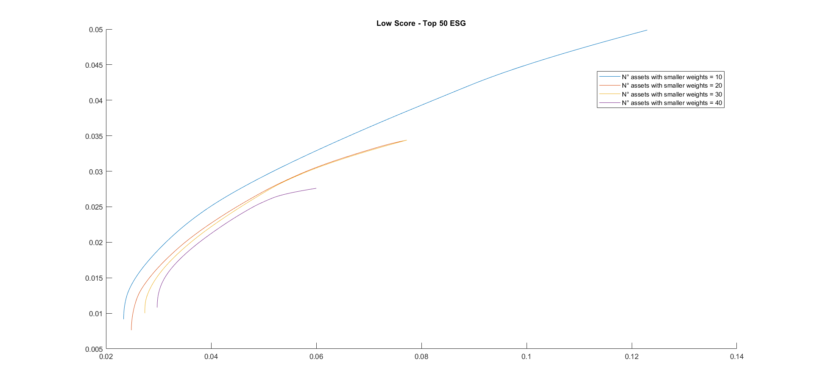
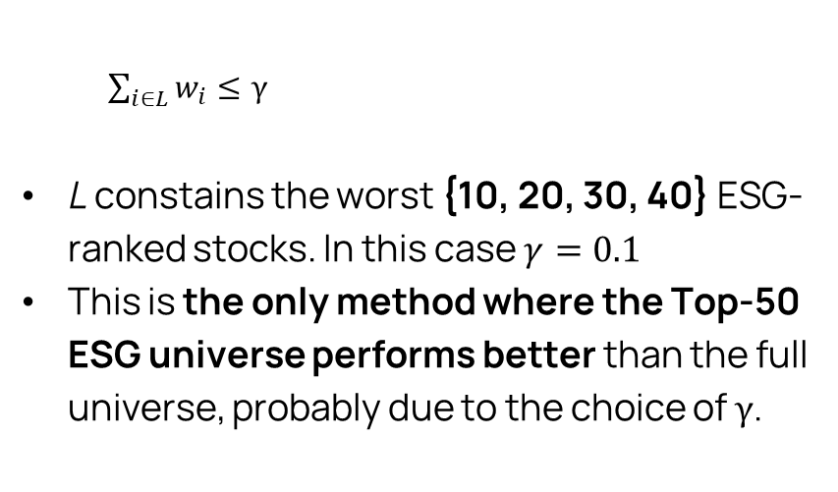
ESG Integration via Linear Limits on Low-Score Assets
{
$\sum_{i∈L}{w_{i}}≤γ$
L constains the worst {10, 20, 30, 40} ESG-ranked stocks. In this case $γ=0.1$
This is the only method where the Top-50 ESG universe performs better than the full universe, probably due to the choice of $γ$.
Minimum Variance Portfolio
Volatility typically 13–14%, with Sharpe Ratios < 1 and Calmar Ratios < 1.2.
Considering the Top 50 ESG Universe Sharpe Ratios increase toward ≈ 1.8, while Drawdowns remain small ( > −5%)

Slide 11
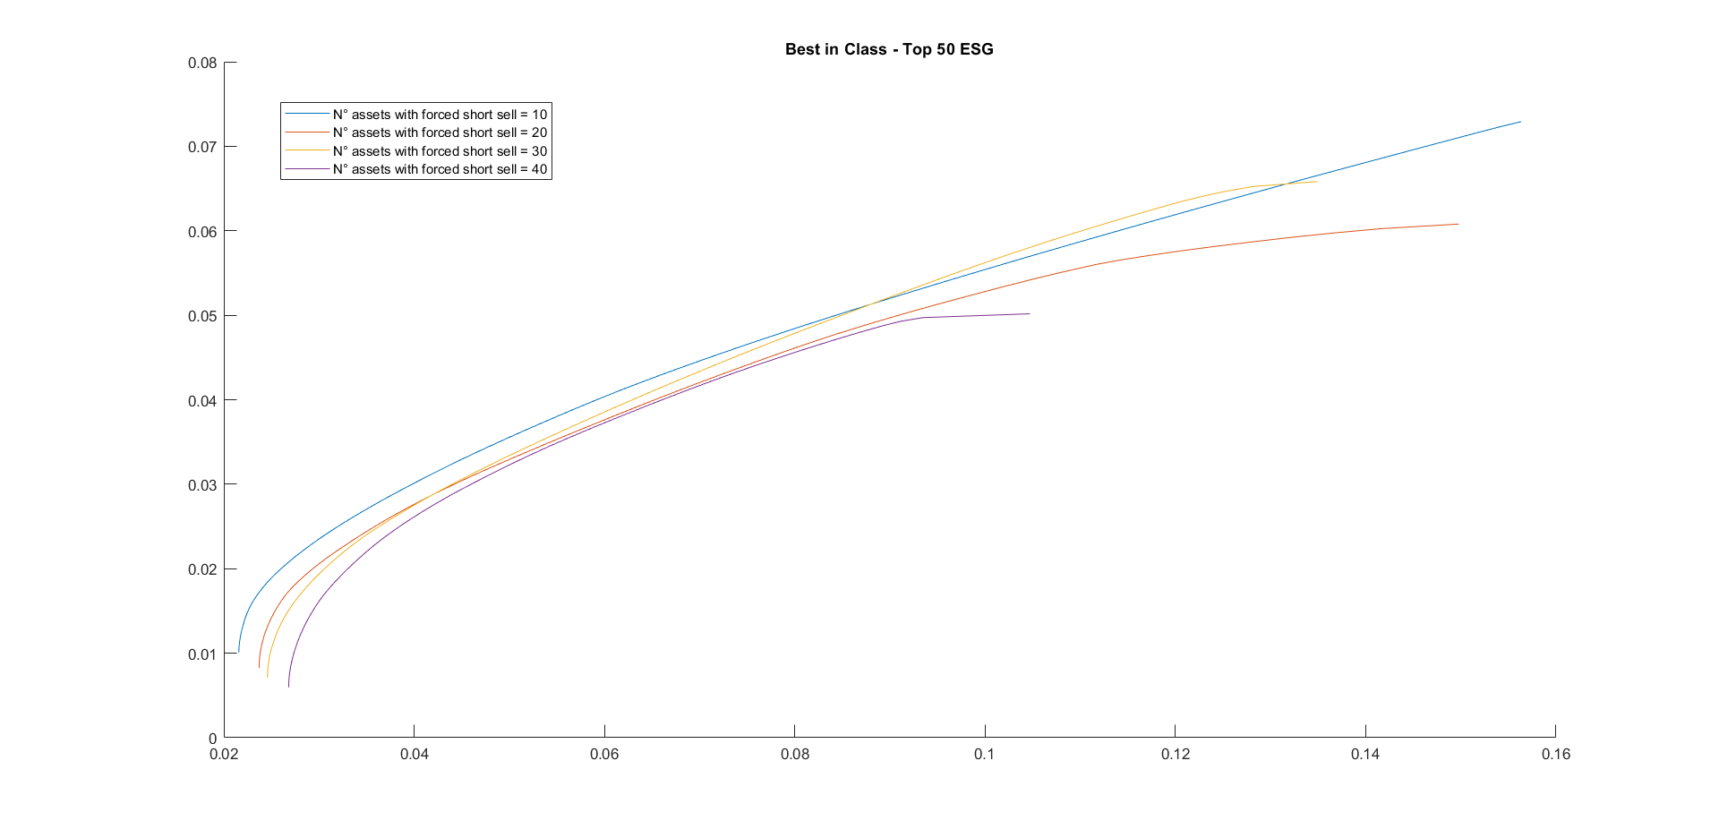
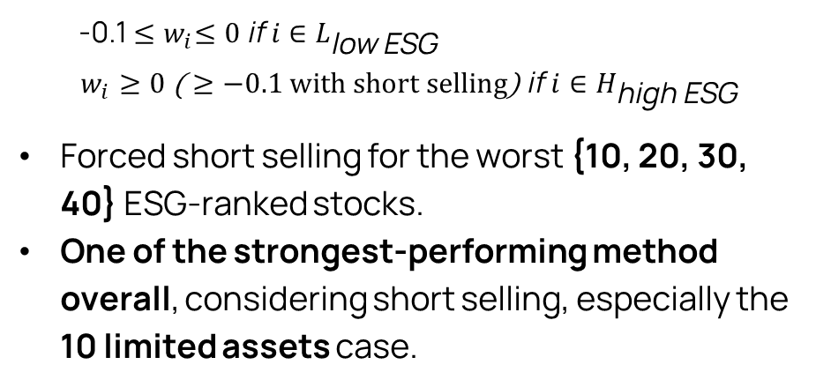
ESG Integration via Best-in-Class: Long/Short Constraints
-0.1 ${≤w}_{i}≤0 \text{if} i∈L_{\text{low} \text{ESG}}$
$$w_{i}≥0 \text{(}≥−0.1 with short selling\text{) }\text{if} i∈H_{\text{high} \text{ESG}}$$
Forced short selling for the worst {10, 20, 30, 40} ESG-ranked stocks.
One of the strongest-performing method overall, considering short selling, especially the 10 limited assets case.
{
Minimum Variance Portfolio
Volatility is around 15% , while Drawdowns are < -15%.
Short-selling enhances results: Sharpe Ratios rise toward 1.5-1.6 and Calmar Ratios exceed 2 consistently.

Slide 12
Weights Forecasting

Slide 13



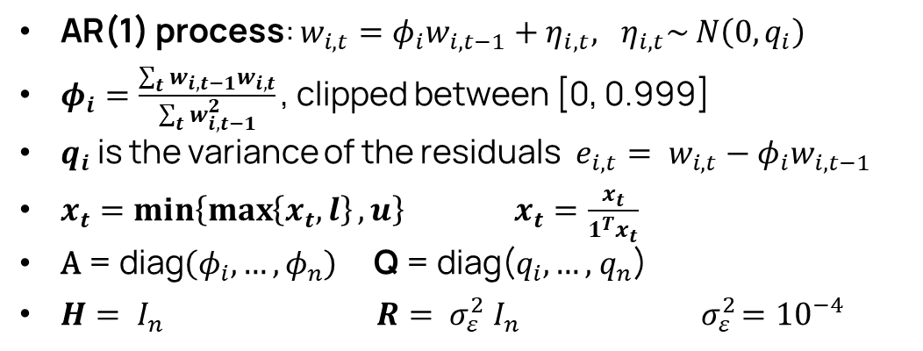
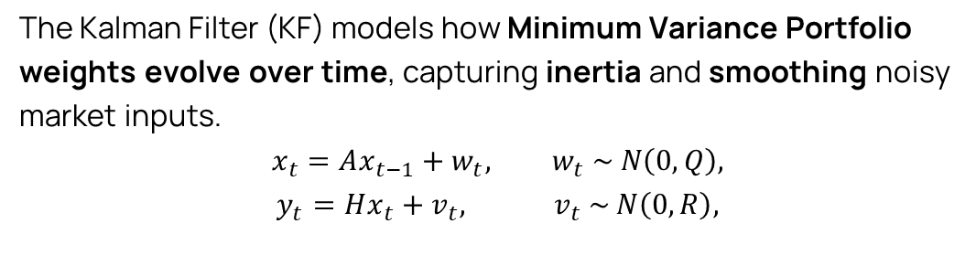
Kalman Filter Overview
The Kalman Filter (KF) models how Minimum Variance Portfolio weights evolve over time, capturing inertia and smoothing noisy market inputs.
$$x_{t}=Ax_{t−1}+w_{t}, w_{t}\text{ ∼ }N\left(0,Q\right)\text{,}$$
$$y_{t}=Hx_{t}+v_{t}, v_{t}\text{ ∼ }N\left(0,R\right)\text{,}$$
Data from 2015–2019 are used to estimate MV portfolios for the 2020-2022 period for each month.
For each month of 2023, the KF predicts next-month weights using the previous estimated MV portfolios.
Out-of-sample evaluation over the following 12 months (including 2024).
Same metrics as in the first chapter, with L1, L2 and Cosine Similarity used to evaluate KF reliability.
AR(1) process: $w_{i,t}=φ_{i}w_{i,t−1}+η_{i,t}, η_{i,t}\text{∼ }N\left(0,q_{i}\right)$
$φ_{i}=\frac{\sum_{t}{w_{i,t−1}w_{i,t}}}{\sum_{t}{w_{i,t−1}^{2}}}\text{,}$ clipped between [0, 0.999]
$q_{i}$ is the variance of the residuals$e_{i,t}= w_{i,t}−φ_{i}w_{i,t−1}$
$x_{t}=min\left\{\max\left\{x_{t},l\right\},u\right\} x_{t}=\frac{x_{t}}{1^{T}x_{t}}$
$\text{A} \text{= }\text{diag}\left(φ_{i},…,φ_{n}\right) \text{Q} \text{= }\text{diag}\text{(}q_{i},…\text{,}{ q}_{n}\text{)}$
$H= I_{n} R= σ_{ε}^{2}$ $I_{n} { σ}_{ε}^{2}={10}^{−4}$

Slide 14
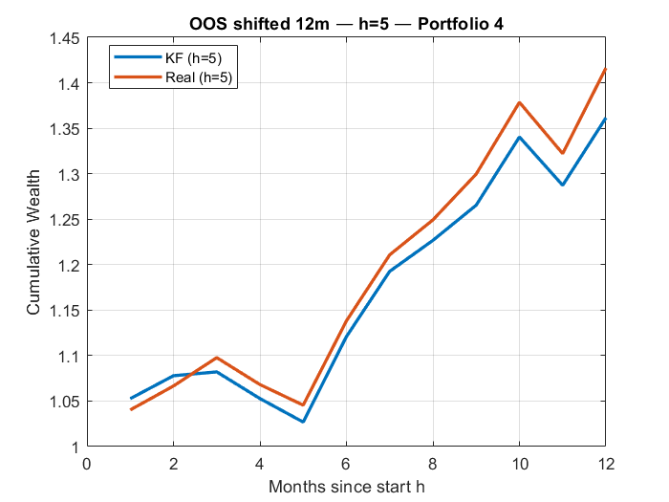
Best-in-Class - Forecasting
Sharpe Ratio | Volatility (%) | MDD (%) | Calmar Ratio | Δ Return (Real – KF)
2 – 2.5 | 12.5 to 17 | > - 8 | 6 – 8 | 2–4%
Cosine Similarity | L1 Weights | L2 Weights
0.8 – 0.9 | 0.1 – 0.5 | 0.05 – 0.15
The Kalman Filter returns present lower volatility, but slightly lower returns compared to the realized portfolios, while maintaining coherent trajectories.

Slide 15
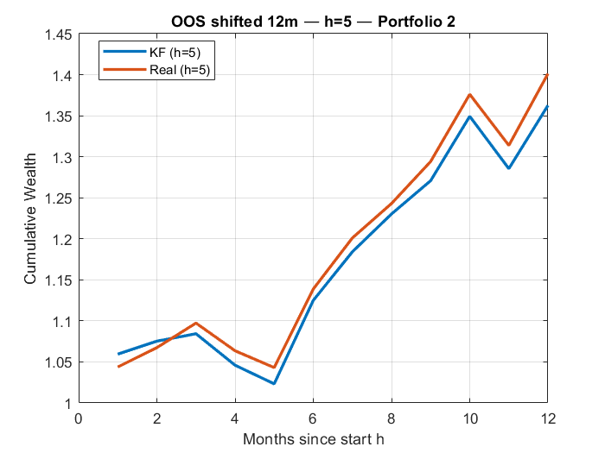
Linear Limits on Low-ESG Assets – Forecasting
Sharpe Ratio | Volatility (%) | MDD (%) | Calmar Ratio | Δ Return (Real – KF)
2 – 2.5 | 12 to 16 | > - 9 | 5 – 8 | 3–6%
Cosine Similarity | L1 Weights | L2 Weights
0.8 – 0.9 | 0.15 – 0.6 | 0.1 – 0.2
The Kalman Filter returns maintain stable trajectories, with lower volatility with respect to the previous case. However, the returns are generally lower.

Slide 16
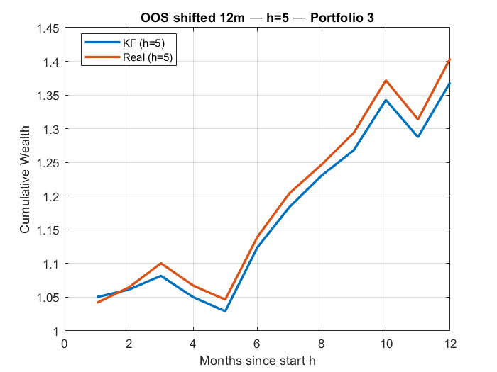
ESG Threshold Constraints – Forecasting
Sharpe Ratio | Volatility (%) | MDD (%) | Calmar Ratio | Δ Return (Real – KF)
2 – 2.5 | 12 to 15 | > –5 | 6 – 10 | 2–4%
Cosine Similarity | L1 Weights | L2 Weights
0.9 – 0.99 | 0.05 – 0.5 | 0.03 – 0.15
This model performs best overall, with the lowest volatility and drawdowns, and the strongest tracking accuracy (Cosine, L1, L2).

Slide 17
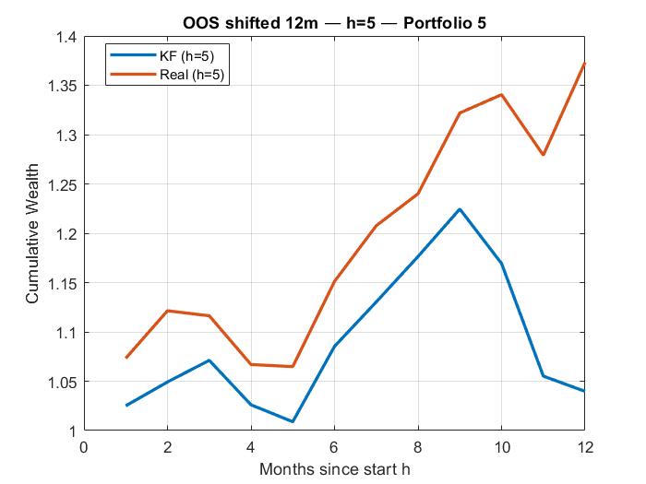
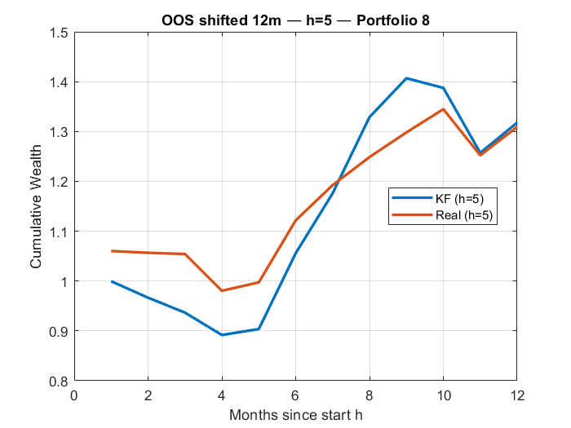
Negative Screening - Forecasting
Sharpe Ratio | Volatility (%) | MDD (%) | Calmar Ratio | Δ Return (Real – KF)
0.8 – 1.6 | Up to 25 | Up to -25 | 2 – 5 | 8–15%
Cosine Similarity | L1 Weights | L2 Weights
It can reach values close to 0 | 0.87 – 2.9 | 0.16 – 0.57
The combination of high volatility and collapsing cosine similarity makes this the worst-performing ESG configuration in the dynamic analysis.

Slide 18
Conclusions

Slide 19
Static ESG Frontiers
Negative ESG premium observed: portfolios with strong sustainability requirements systematically show
lower Sharpe and higher volatility, while soft methods, in particular Best-in-Class and Linear Constraint cases, preserve diversification and deliver the best risk–return profile, especially under limited short-selling.
Hard exclusions and sector-based screening produce significant diversification loss
Moderate ESG constraints bring a moderate risk balance, extreme constraints materially reduce efficiency
Dynamic Forecasting with the Kalman Filter
The Kalman Filter provides stable and economically meaningful trajectories, reducing estimation noise.
Across ESG configurations, KF portfolios achieve returns and Sharpe ratios close to the real portfolios, but
lower volatility and smaller drawdowns.
Tracking accuracy is excellent for Best-in-Class and Linear Constraint configuration but deteriorates under Negative Screening.

Slide 20

Future Developments
Extend multi-factor state models
Explore other dynamic models in order to introduce short selling in the forecasting part.
Integrate transaction costs.
Consider carbon emissions instead of ESG Scores
Azzone, Barucci & Stocco: stricter ESG thresholds reduce performance and diversification.
Consistent with Blitz & Swinkels: moderate exclusions have limited cost; broad exclusions materially damage efficiency.
Matches De Spiegeleer: Best-in-Class strategies preserve diversification and maintain frontier proximity.

Slide 21
Thanks for the attention

Slide 22
Annex

Slide 23
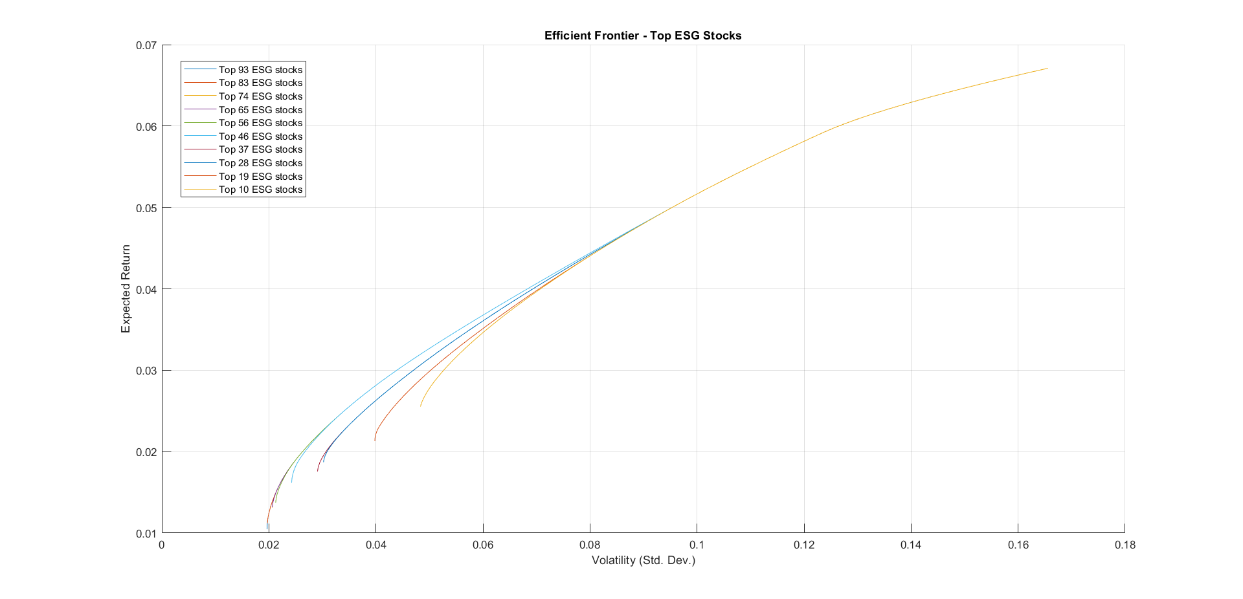
Top ESG Scores Frontiers Analysis
The investable universe is progressively restricted to K assets with the highest ESG scores (K = 10, 19, 28, …, 93).
Frontiers built with fewer high-ESG assets are dominated by those with more assets
Reducing K lowers diversification

Slide 24
Kalman Filter Overview

Slide 25
 | Sharpe Ratio | Volatility (%) | MDD (%) | Calmar Ratio | Δ Return (Real – KF)
Best-in-Class | 2 – 2.5 | 12.5 to 17 | > - 8 | 6 – 8 | Real slightly higher (≈ +2–4%)
Linear Limits | 2 – 2.5 | 12 to 15 | > - 9 | 5 – 8 | Real moderately higher (≈ +3–6%)
Linear ESG Constraints | 2 – 2.5 | 12 to 15 | > –5 | 6 – 10 | Real slightly higher (≈ +2–4%)
Negative Screening | 0.8 – 1.6 | Up to 25 | Up to -25 | 2 – 5 | Real clearly higher (≈ +8–15%)

Slide 26
 | Cosine Similarity | L1 Weights | L2 Weights
Best-in-Class | 0.8 – 0.9 | 0.1 – 0.5 | 0.05 – 0.15
Linear Limits | 0.8 – 0.9 | 0.15 – 0.6 | 0.1 – 0.2
Linear ESG Constraints | 0.9 – 0.99 | 0.05 – 0.5 | 0.03 – 0.15
Negative Screening | It can reach values close to 0 | 0.87 – 2.9 | 0.16 – 0.57

